Slide 1
FASHION DESIGNING
UNIT I

Slide 2
TERMS RELATED TO FASHION INDUSTRY:
Fashion terminology is the vocabulary for the fashion industry, from the design studio to the runway to retail stores.
fashion-related words that differentiate the fashion talk of the common man from the fashion elite, We can call it the fashion jargon (terms) tossed around by the designers and editors who decide the course of fashion.
The fashion connoisseurs (a person who knows a lot about art, good food, music, etc.) use them as part of their everyday conversation.
Some of these words are common terms but some were unfamiliar and technical.
FASHION
STYLE
FAD
CLASSIC
COLLECTION
CHIC
CUSTOM MADE
MANNEQUIN
FASHION SHOW
TREND
FORECASTING
HIGH FASHION
FASHION CYCLE
HAUTE COUTURE
FASHION DIRECTOR
FASHION EDITOR
LINE
KNOCK OFF
AVANT-GARDE
BUYING HOUSE
FASHION MERCHANDISING
PRET-A-PORTER
SAMPLE
FASHION LEADERS
FASHION INNOVATORS
FASHION MOTIVATION
FASHION VICTIM
FASHION FOLLOWERS

Slide 3
FASHION: current style
“Fashion” is the most common term used as a synonym for the current style in clothing.
People who write about fashion are more likely to use a definition that says,
Fashion has two elements.
(1) Accepted by many people
(2) Its acceptance lasts for a relatively short period of time.
Fashion does not exist in all cultures and historic periods. It seems to have begun in the Western Europe in the late middle ages.
At that time the nobility were the originators of fashions, and the lower classes copied upper class styles (known as the trickle-down theory of fashion).

Slide 4
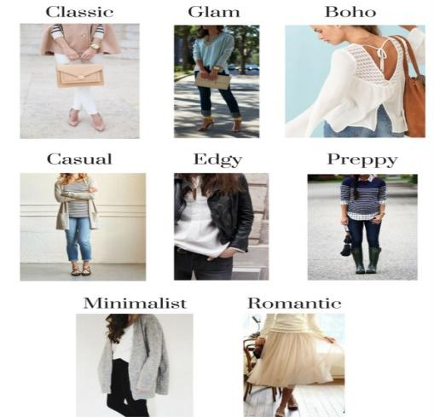
STYLE: personal style/individual
In the fashion world, “style” is usually shorthand for “personal style,” or the way an individual
expresses themselves through aesthetic choices such as their clothing, accessories, hairstyle,
and the way they put an outfit together.
Style also known as Aesthetics.

Slide 5
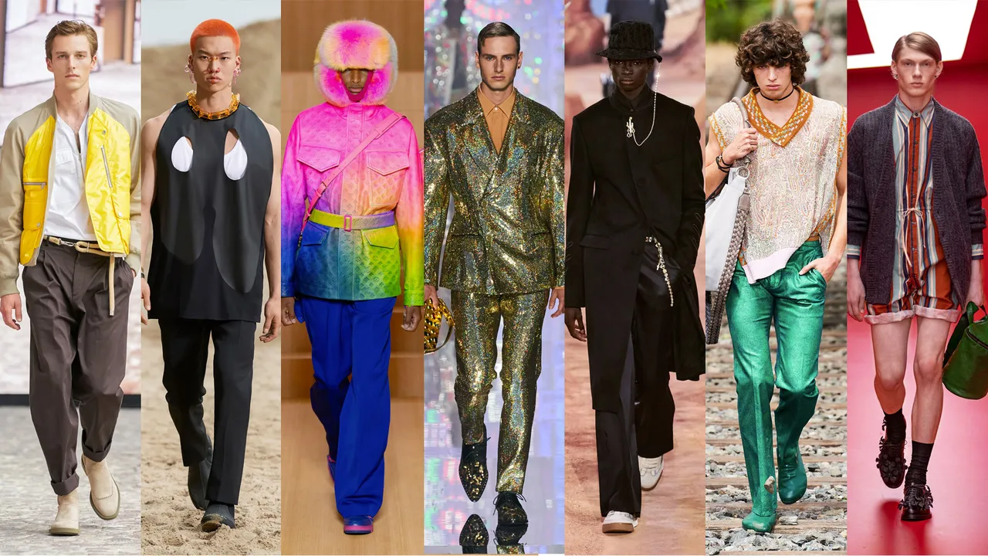
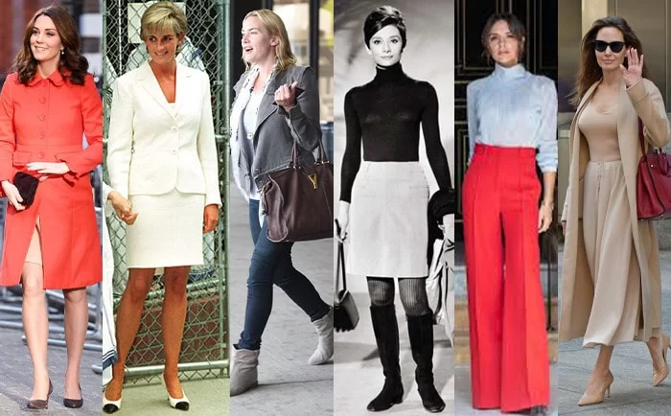
FAD: A temporary, passing fashion.
Generally, it is an unusual garment, accessory, or look that has great appeal to many people
for a short period of time.
A style or activity that suddenly becomes popular but which usually does not stay
popular for very long.
A short lived fashion; the popularity fades pretty fast after a burst.
CLASSIC: Long term fashion
A style or design that satisfies a basic need and remains a general fashion acceptance for an
extended period of time.
A few fashion designs stay for a very long period (known as classic fashion)
Classic clothing style describes a person's personality of preference
towards timeless looks, simple and elegant cuts, choice of fine natural fabrics,
and matching accessories such as leather shoes and handbags.

Slide 6
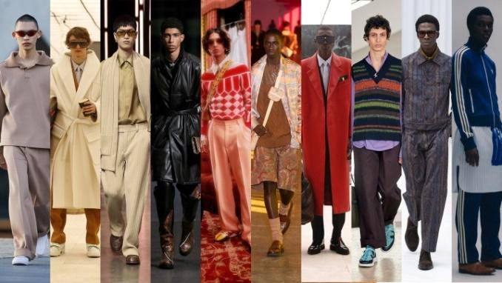
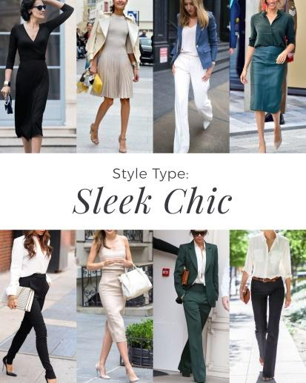
COLLECTION:
Collection is a synonym, and is more often used in high fashion
A secondary line consists of a less expensive group of styles made by a manufacturer and sold to a different market than the primary line. Usually held twice a year in spring/summer and fall/ winter.
CHIC: Stylish / sophisticated.
Chic is fashionable or stylish. Chic can also be used as a noun to mean a specific type of stylishness or coolness, like a downtown urban chic (skinny jeans, perhaps), or nerdy chic (big glasses). Chic is a French word that pronounced as “sheek” and not “chick,”

Slide 7
Reference Video:
https://youtu.be/2Gj5kjEH908
https://www.youtube.com/watch?v=DKqIUm4cYHo&pp=ygUOZmFkIGluIGZhc2hpb24%3D

